Slide 1
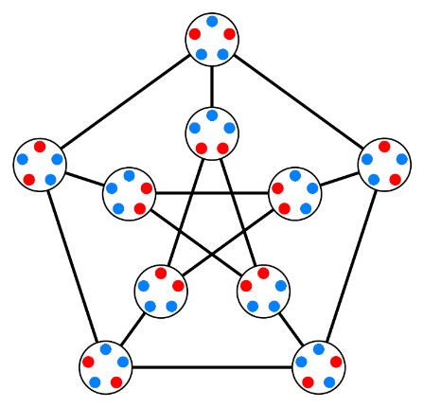
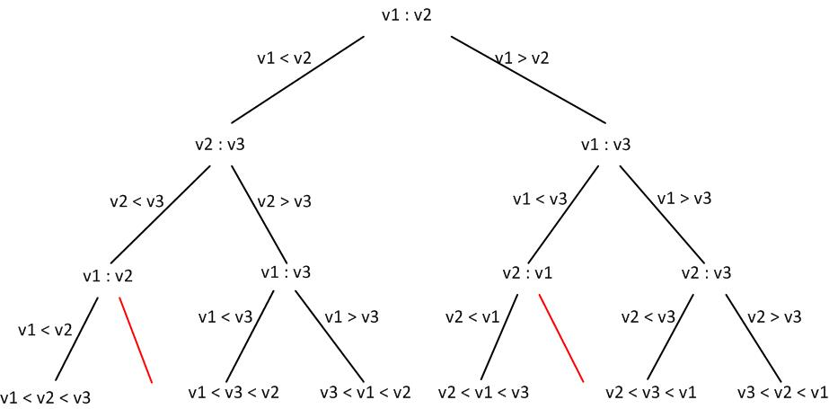
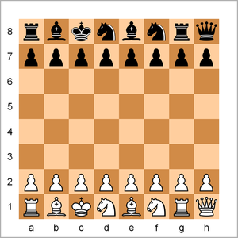
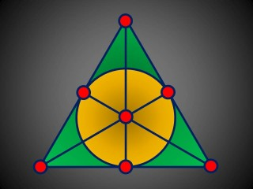
Discrete Structures (Discrete Mathematics)
Mr. Asim Raza
Email: asim.raza@ucp.edu.pk

Slide 2
Discrete World:
What is Discrete Structures?
Discrete Objects
Separated from each other , distinctOpposite of continuous)
e.g., integers, people, house,
Continuous objects: e.g., real number
Discrete Structures
The abstract mathematical structures used to represent
discrete objects and relationships between the objects
e.g. sets, relations, graphs

Slide 3
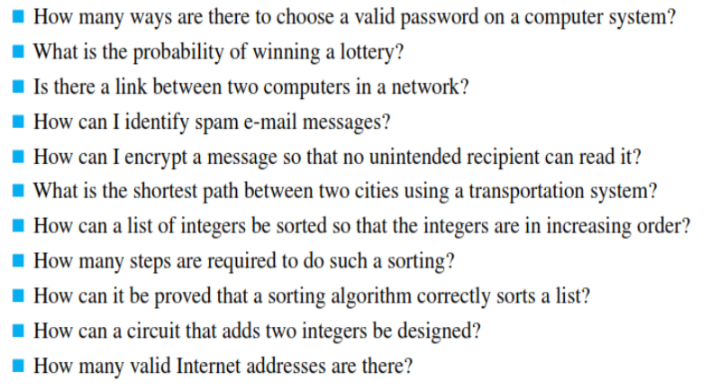
Uses of Discrete Structures in Computer Science

Slide 4
The Problems we solve:
One way to get a feel for the subject is to consider the types of problems you solve in discrete math. Here are a few simple examples:

Slide 5
Counting possible passwords
The Problems we solve:
Each user on a computer system has a password, which is six to eight characters long, where each character is an uppercase letter or a digit. Each password must contain at least one digit. How many possible passwords are there?

Slide 6
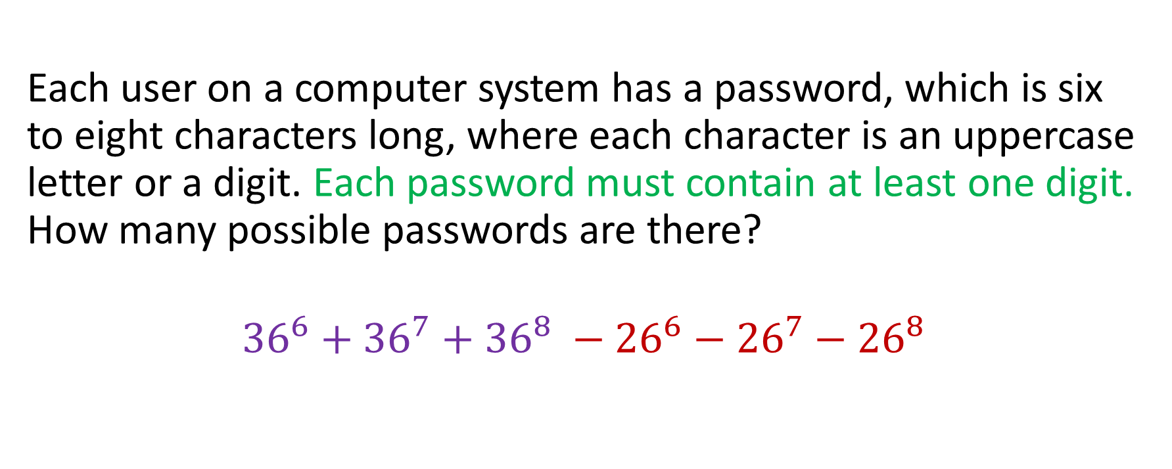
Counting possible passwords
The Problems we solve:
Each user on a computer system has a password, which is six to eight characters long, where each character is an uppercase letter or a digit. Each password must contain at least one digit. How many possible passwords are there?
$${36}^{6}+{36}^{7}+{36}^{8} −{26}^{6}−{26}^{7}−{26}^{8}$$

Slide 7
Counting possible passwords
The Problems we solve:
Each user on a computer system has a password, which is six to eight characters long, where each character is a letter or a digit. Each password must contain at least ONE DIGIT, ONE UPPER CASE and ONE LOWER CASE letter. How many possible passwords are there?

Slide 8
Examples – The Problems we solve:
The most popular mathematician in the world is throwing a party for all of his friends. As a way to kick things off, they decide that everyone should shake hands.
Assuming all 10 people at the party each shake hands with every other person (but not themselves, obviously) exactly once, how many handshakes take place?

Slide 9
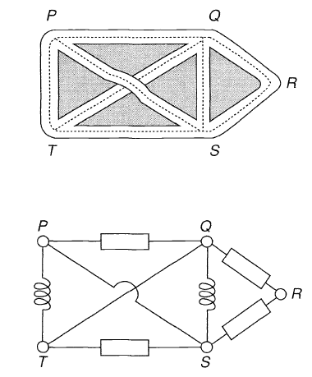
Applications: Graphs
Examples – The Problems we solve:
Part of a road map
Part of an electric circuit

Slide 10
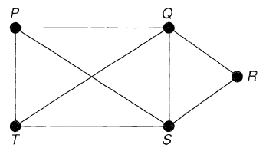
Applications: Graphs
Examples – The Problems we solve:
Essentially the same graph:
Part of a road map
Part of an electric circuit

Slide 11
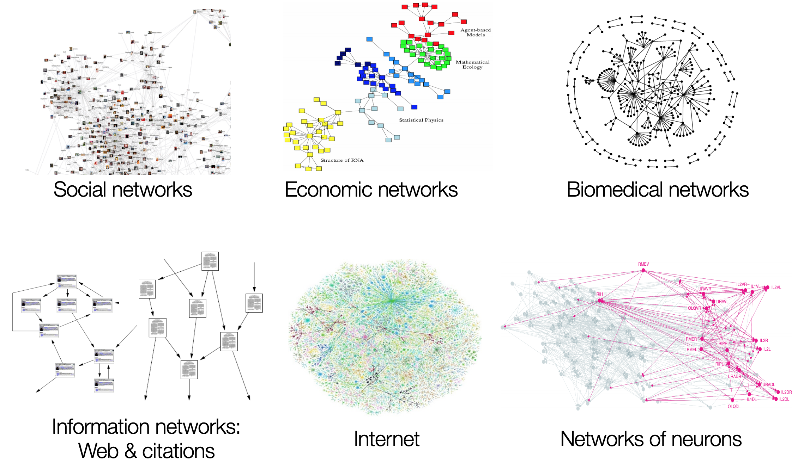
Applications: A Gallery of Graphs

Slide 12
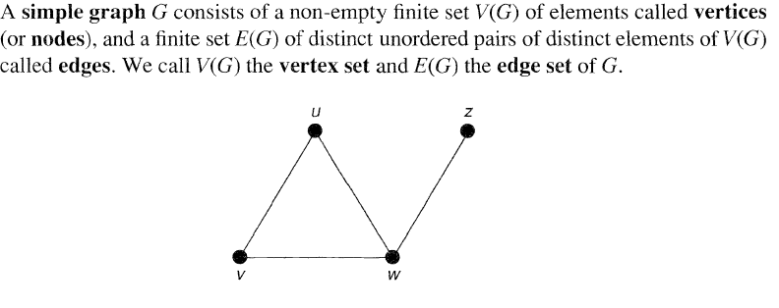
Applications: Counting Graphs
Examples – The Problems we solve:

Slide 13
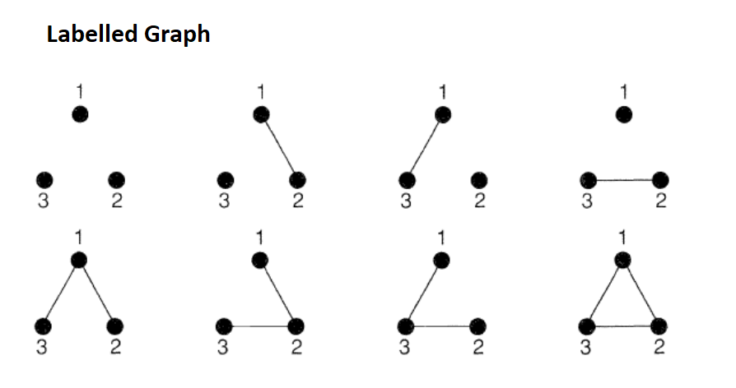
Applications: Counting Graphs
Examples – The Problems we solve:

Slide 14
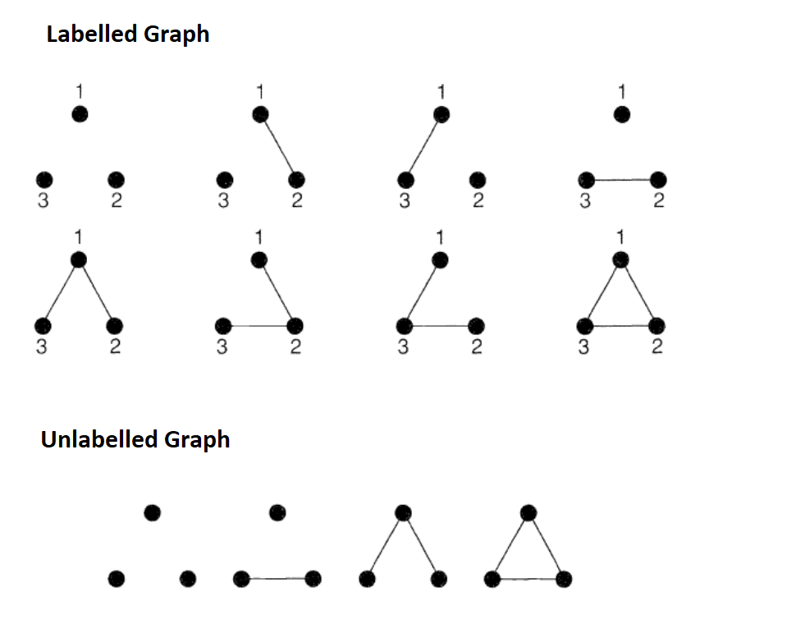
Applications: Counting Graphs

Slide 15
Applications: Solving Maze Graphs

Slide 16
Bijections (or the art of noticing equivalences)
Examples – The Problems we solve:
The three Guddoo siblings, Ali, Bilal, and Camaal, have integer ages that sum to 15. How many possible distributions of ages are there?
Note: It is possible that an age can be 0, which means that the child was just born.

Slide 17
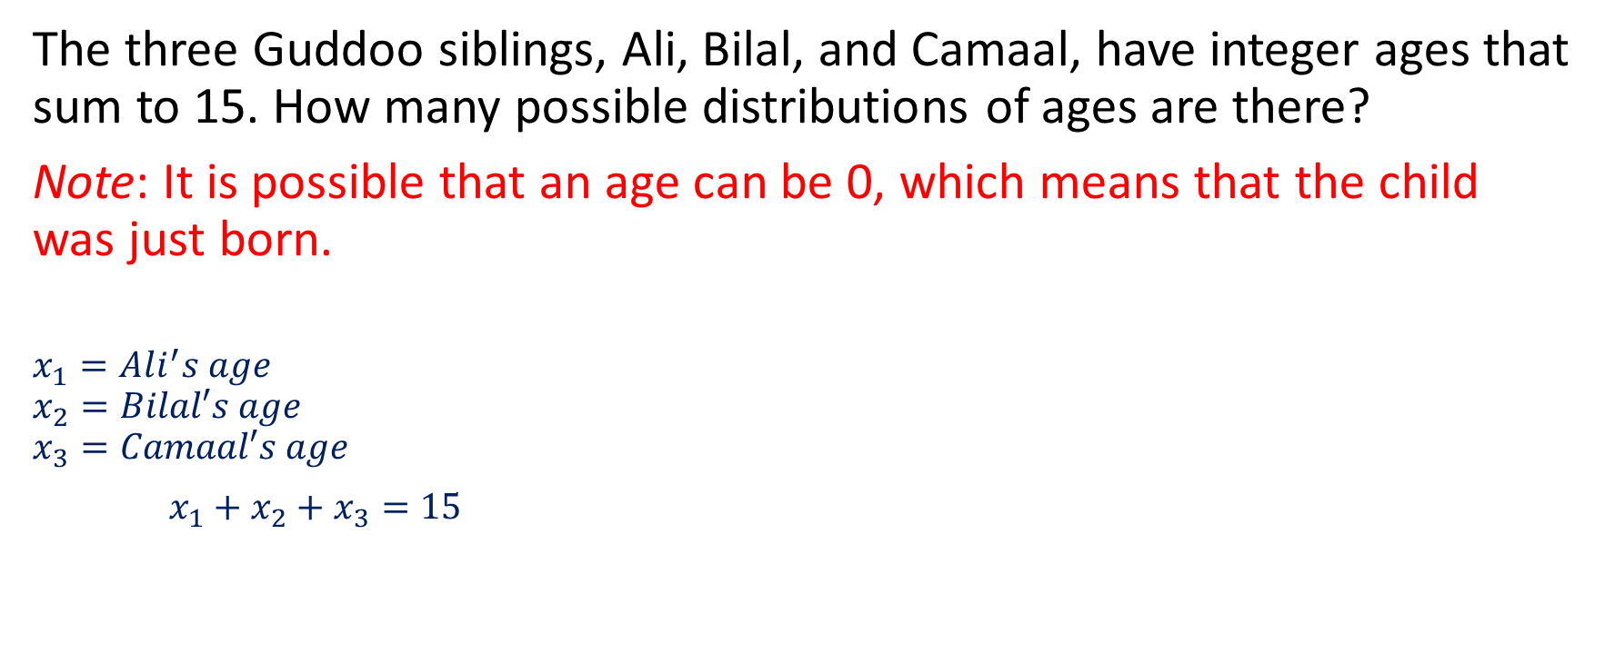
Bijections (or the art of noticing equivalences)
The three Guddoo siblings, Ali, Bilal, and Camaal, have integer ages that sum to 15. How many possible distributions of ages are there?
Note: It is possible that an age can be 0, which means that the child was just born.
$$x_{1}=Ali^{′}s age$$
$$x_{2}=Bilal′s age$$
$$x_{3}=Camaal′s age$$
$x_{1}+x_{2}+x_{3}=15$

Slide 18
Bijections (or the art of noticing equivalences)
The three Gudoo siblings, Ali, Bilal, and Camaal, have integer ages that sum to 15. How many possible distributions of ages are there?
Note: It is possible that an age can be 0, which means that the child was just born.
One can establish a bijection between the set of distributions of ages and a set of combinations. Consider the arrangement of stars and bars below:
⋆⋆∣⋆⋆⋆⋆∣⋆⋆⋆⋆⋆⋆⋆⋆⋆
This arrangement corresponds to the following distribution of ages:
Ali - 2, Bilal - 4, Camaal - 9.
How many ways to place the 2 bars among the 15 stars?

Slide 19
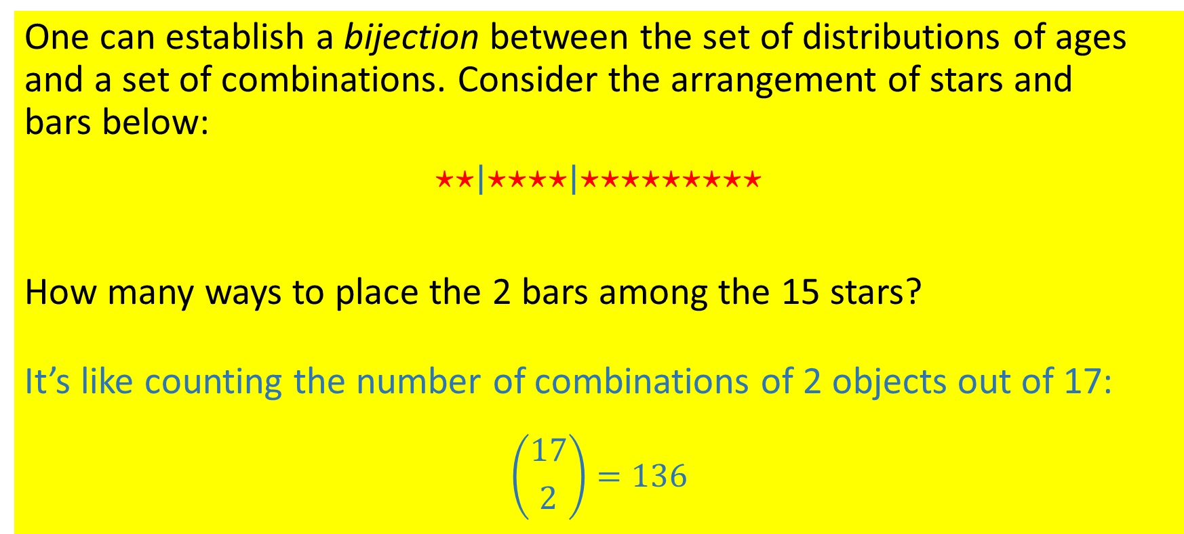
Bijections (or the art of noticing equivalences)
One can establish a bijection between the set of distributions of ages and a set of combinations. Consider the arrangement of stars and bars below:
⋆⋆∣⋆⋆⋆⋆∣⋆⋆⋆⋆⋆⋆⋆⋆⋆
How many ways to place the 2 bars among the 15 stars?
It’s like counting the number of combinations of 2 objects out of 17:
$$\left({17 \atop 2}\right)=136$$

Slide 20
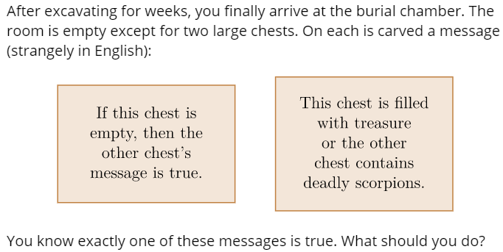
Examples – The Problems we solve:
In the world of Indiana Jones,

Slide 21
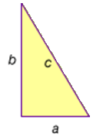
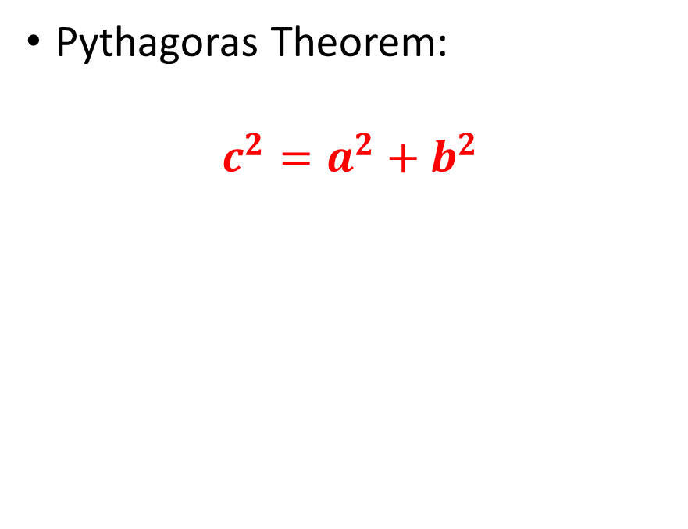
Proofs: How to prove a claim
Examples – The Problems we solve:
Pythagoras Theorem:
$$c^{2}=a^{2}+b^{2}$$

Slide 22
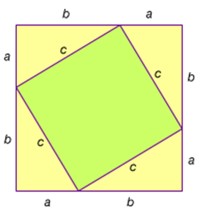
Proofs
Examples – The Problems we solve:
Pythagoras Theorem:
$$c^{2}=a^{2}+b^{2}$$

Slide 23
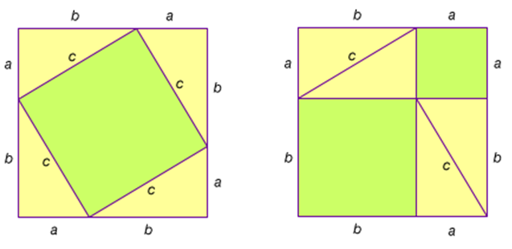
Proofs
Examples – The Problems we solve:
Pythagoras Theorem:
$$c^{2}=a^{2}+b^{2}$$

Slide 24

Claim: $n^{2}+n+41$ gives a Prime Number; $n$ is some non-negative integer.

Slide 25
$n^{2}+n+41$ always gives a Prime Number
0 41 1
1 43 1
2 47 1
3 53 1
4 61 1
5 71 1
6 83 1
7 97 1
8 113 1
9 131 1
151 1
173 1
12 197 1
13 223 1
14 251 1
15 281 1
16 313 1
17 347 1
18 383 1
19 421 1
20 461 1
21 503 1
22 547 1
23 593 1
24 641 1
25 691 1
26 743 1
27 797 1
28 853 1
29 911 1
30 971 1
31 1033 1
32 1097 1
33 1163 1
34 1231 1
35 1301 1
36 1373 1
37 1447 1
38 1523 1
39 1601 1
40 1681 0
41 1763 0
42 1847 1
43 1933 1
44 2021 0
45 2111 1
46 2203 1
47 2297 1
48 2393 1
49 2491 0
50 2591 1

Slide 26
$n^{2}+n+41$ gives a Prime Number
0 41 1
1 43 1
2 47 1
3 53 1
4 61 1
5 71 1
6 83 1
7 97 1
8 113 1
9 131 1
151 1
173 1
12 197 1
13 223 1
14 251 1
15 281 1
16 313 1
17 347 1
18 383 1
19 421 1
20 461 1
21 503 1
22 547 1
23 593 1
24 641 1
25 691 1
26 743 1
27 797 1
28 853 1
29 911 1
30 971 1
31 1033 1
32 1097 1
33 1163 1
34 1231 1
35 1301 1
36 1373 1
37 1447 1
38 1523 1
39 1601 1
40 1681 0
41 1763 0
42 1847 1
43 1933 1
44 2021 0
45 2111 1
46 2203 1
47 2297 1
48 2393 1
49 2491 0
50 2591 1
We need generalized proofs

Slide 27

Always think rational, think imaginative, think out of the box
What is color of the bear
A bear starting from point P, walked one mile due south, then he changed direction and walked one mile due east, then he turned again and walked one mile due north,
and arrived exactly at the point P where he started from.
What color is the bear?

Slide 28
A Computer Scientist is a person who can
construct algorithms based on
conjectures he/she can prove.

Slide 29
A Computer Scientist is a person who can
construct algorithms based on
conjectures he/she can prove.
Algorithms: Efficient and Correct
How do we approach:
Solve a Problem
Construct an Algorithm
Develop Code

Slide 30
A Computer Scientist is a person who can
construct algorithms based on
conjectures he/she can prove.
Algorithms: Efficient and Correct
How do we approach:
Solve a Problem (proofs – problem solving – Discrete Maths)
Construct an Algorithm (Analysis of Algorithms – Data Structures)
Develop Code (All other relevant skills)

Slide 31
A Computer Scientist is a person who can
construct algorithms based on
conjectures he/she can prove.
Algorithms: Efficient and Correct
How do we approach:
Solve a Problem (proofs – problem solving – Discrete Maths)
Construct an Algorithm (Analysis of Algorithms – Data Structures)
Develop Code (All other relevant skills)
A GOOD PROOF:
Existence of a book where God writes nice proofs for all mathematical results.
(Paul Edros) https://en.wikipedia.org/wiki/Paul_Erd%C5%91s https://www.youtube.com/watch?v=9634A0iBw7w

Slide 32
Course Outlines:
Set and its operations (subset, intersection, union, complement, disjoint)
Cartesian Product, Relations and Functions
Time Complexity for Loops
Counting – Sum and Product Rule + Combinations and Permutations
Counting - Pigeonhole principle + Principle of Inclusion-Exclusion (PIE)
Binomial Theorem
Generalized counting - Combination and Permutation
MIDTERM
Graph Theory
Trees
Propositional and Predicate Logic
Basic techniques of proofs
Mathematical induction
Recusion
FINAL

Slide 33
Course Outlines:
Assessments:
Assignments (10 %) – 4 out of 5
Quizzes (10 %) - 5 out of 6
Class Activity (15%) - 8 – 10
Mid Term Exam (25 %)
Final Exam (40 %)

Slide 34
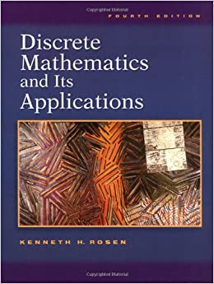
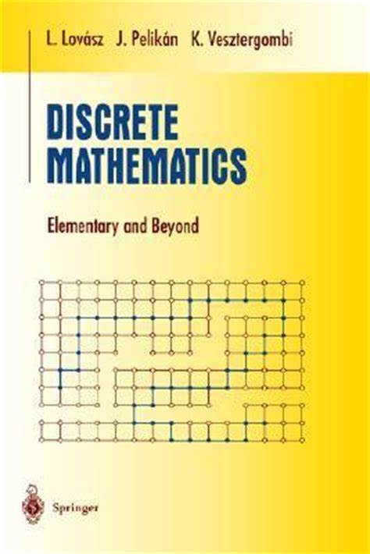
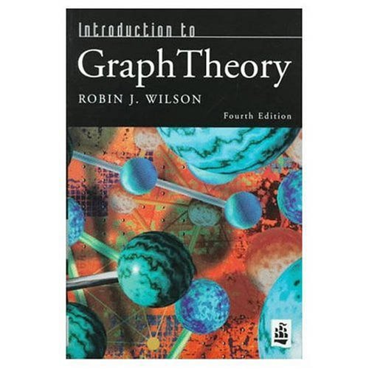
Textbook:
Main Text:
K. Rosen: Discrete Structures and its Applications
Weekly Readings:
L. Lovasz: Discrete Mathematics, Elementary and Beyond
Reference:
R. J. Wilson: Graph Theory

Slide 35
Good Practices
Be on time in class
Be regular (do not miss a single class)
Start assignments on time
Do not miss any assignment or quiz
Come up with good questions (ask in class/after class)
Visit during office hours to discuss your problems/assignments

Slide 36
Bad Practices
Excuses
Coming late in class (remember: quiz will be in 1st 10 min of class)
Come to class without pen and notebooks
Asking for leaves --- Teacher has no authority to grant leaves. Manage your 6 absents as emergency leaves, or request HoD/Dean for extra leaves.
Requesting to increase marks
Coming to class without reading the required text/notes
Copying / plagiarism
Asking to extend the deadline
Using mobile phones in class - Cross talk in class

Slide 37
Set and its Operations

Slide 38
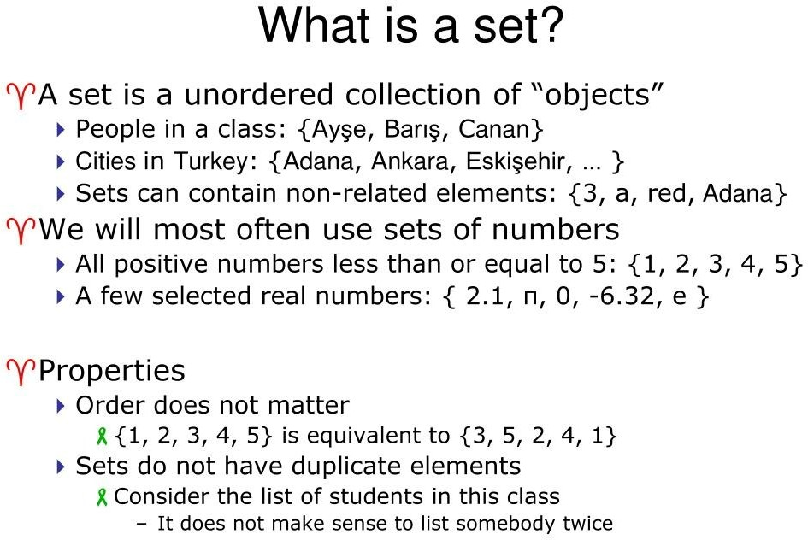
{sara, amna, ali, ahmed, mehwish}

Slide 39
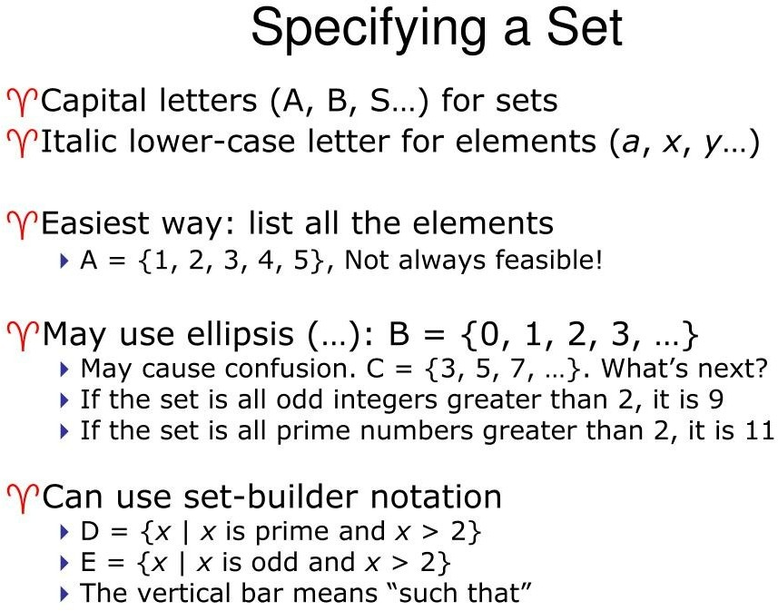

Slide 40
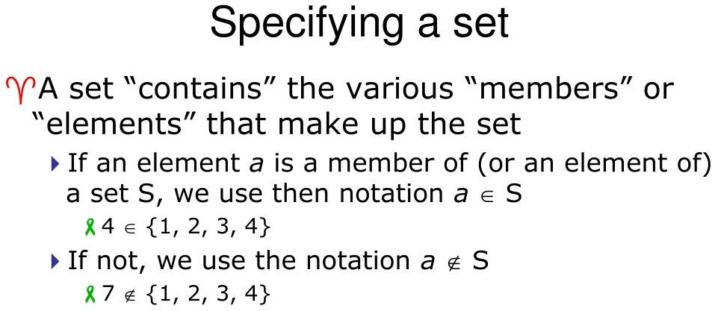

Slide 41
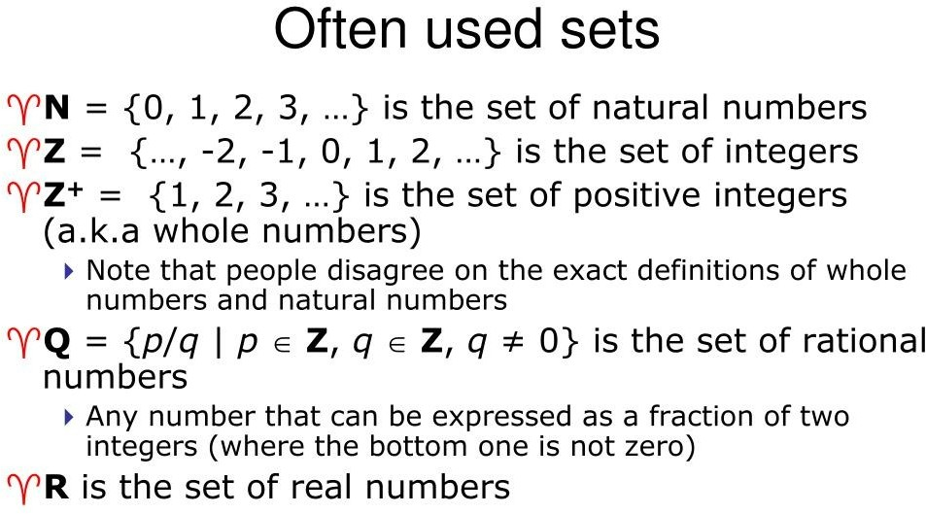

Slide 42
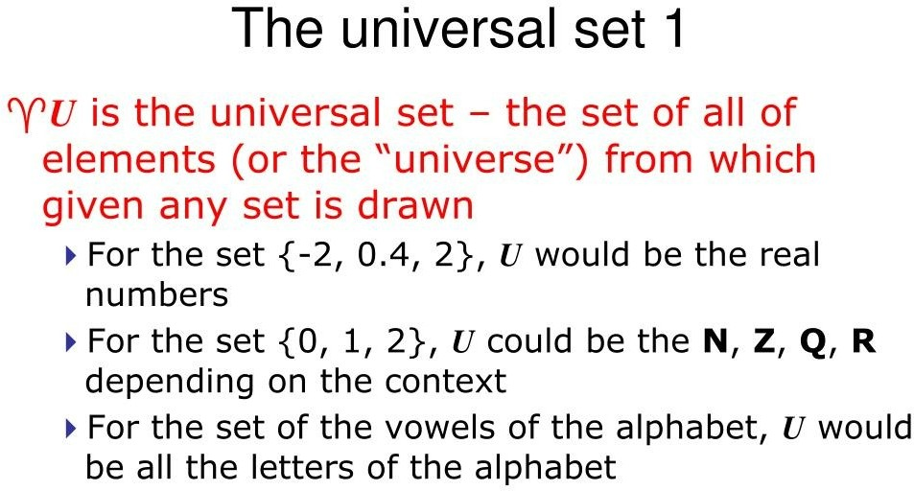

Slide 43
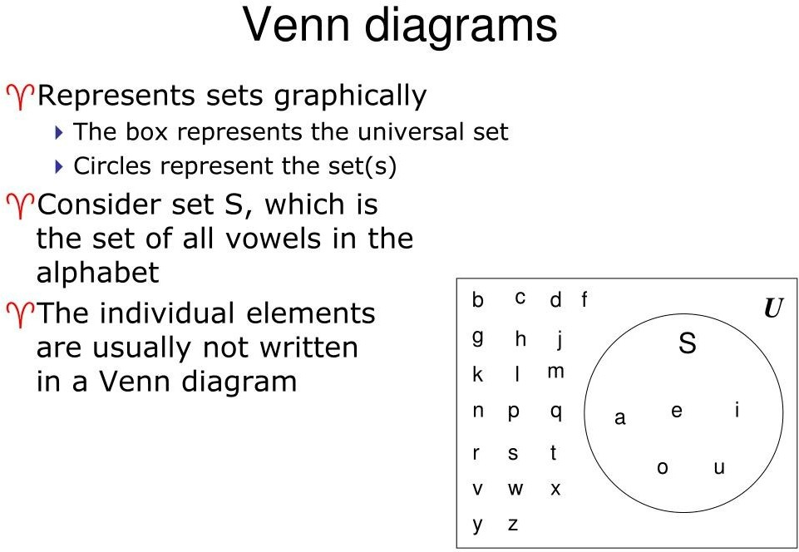

Slide 44
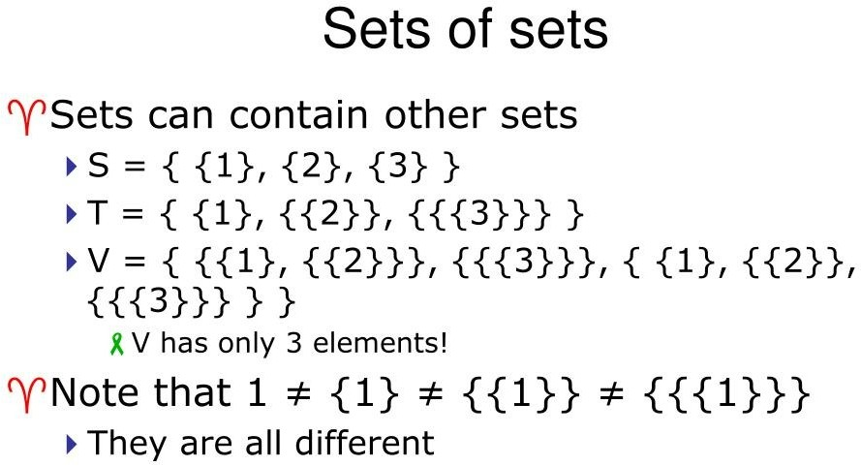

Slide 45
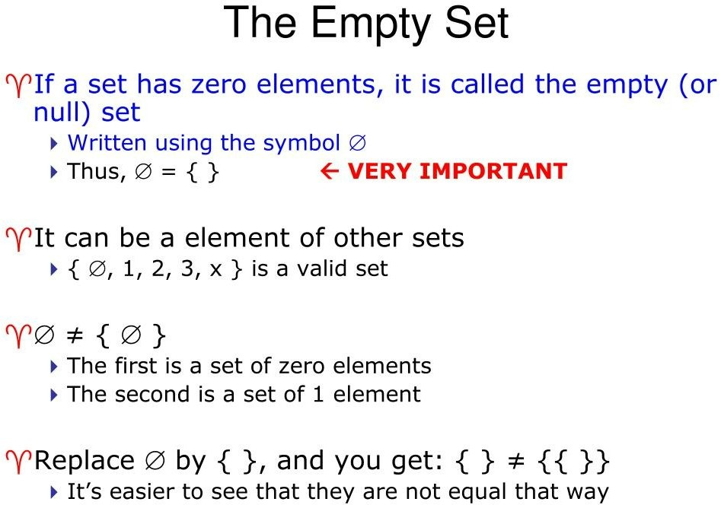

Slide 46
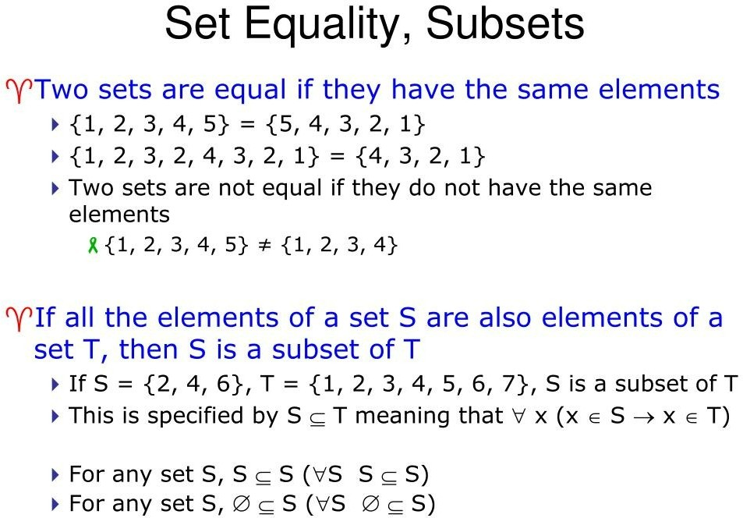

Slide 47
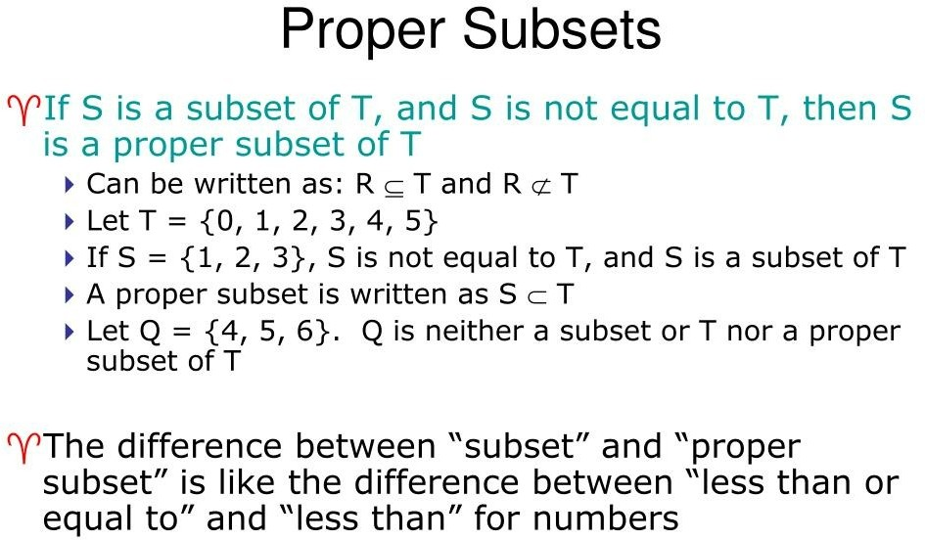

Slide 48
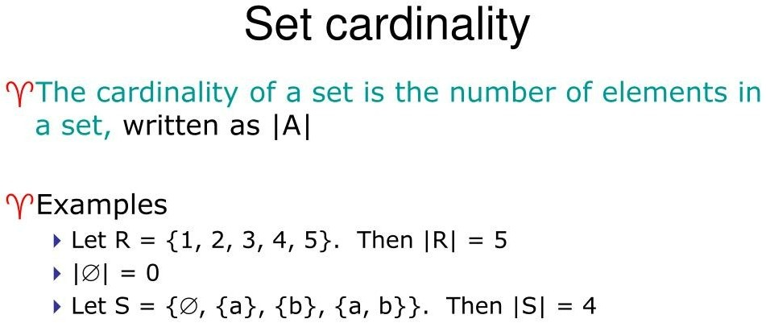

Slide 49
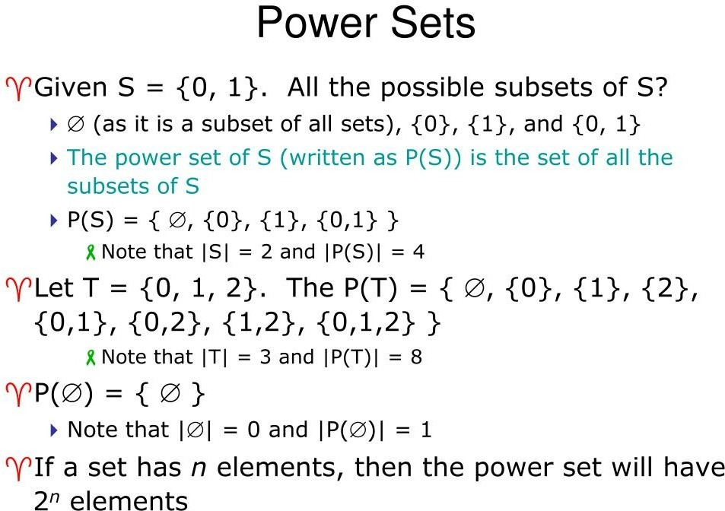

Slide 50
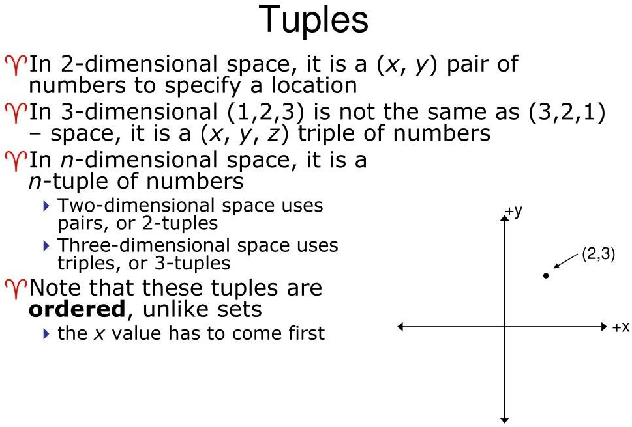

Slide 51
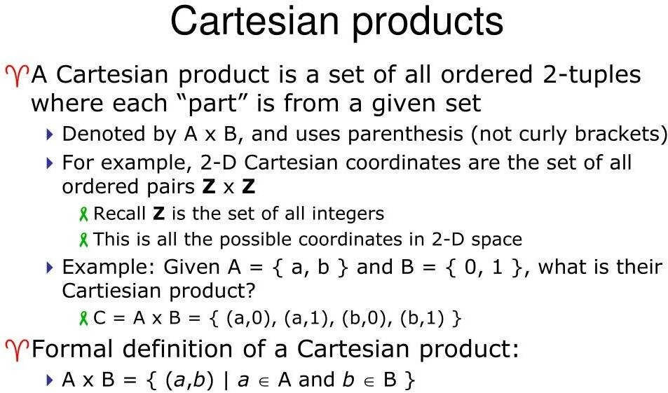

Slide 52
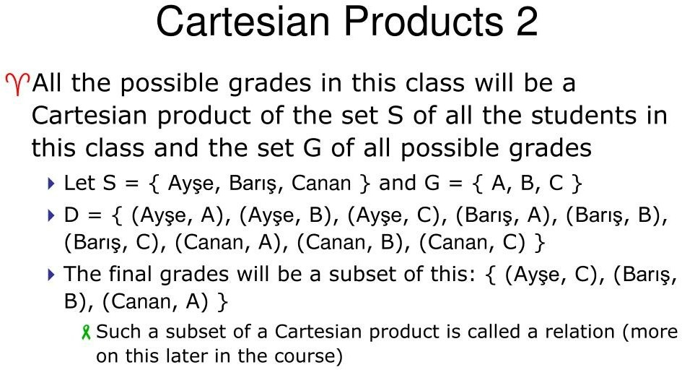

Slide 53
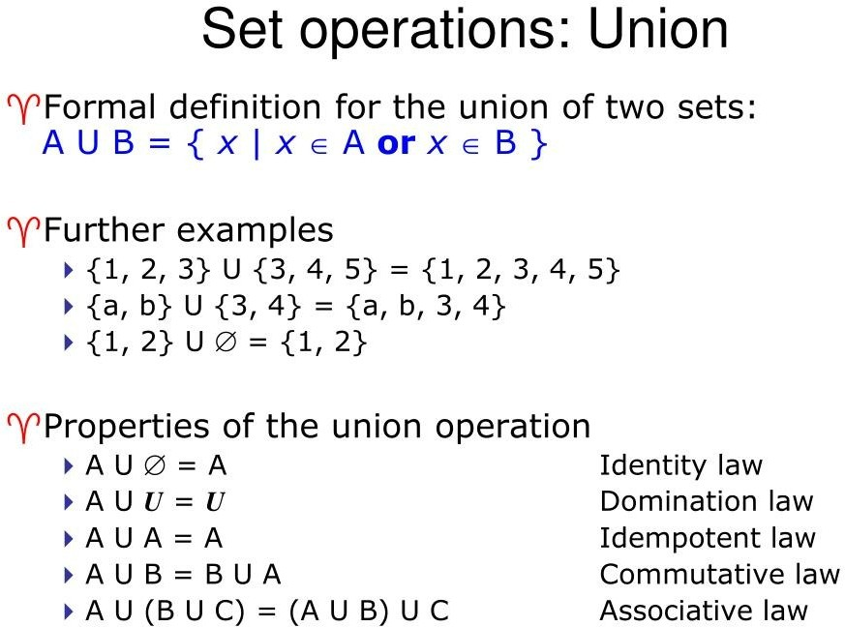
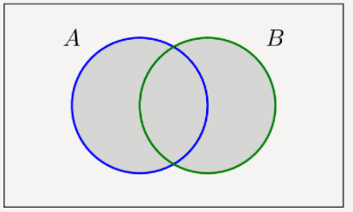

Slide 54
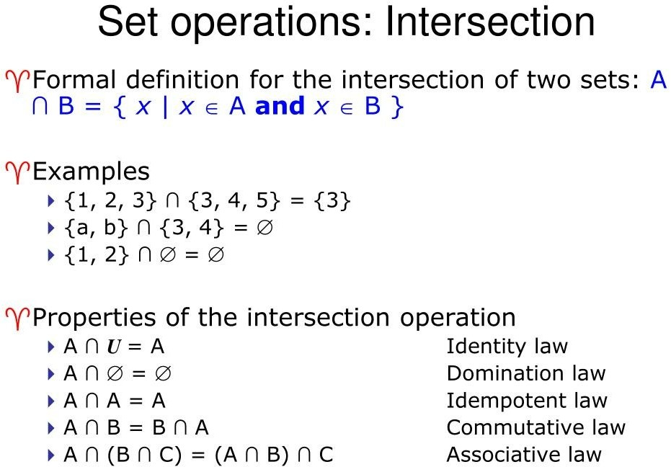
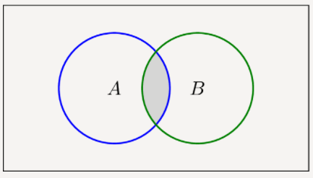

Slide 55
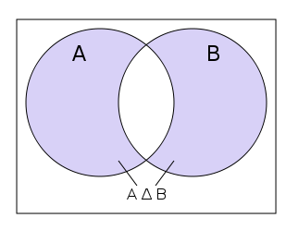
Set operations: Symmetric Difference
A△B= (A∪B) − (A∩B)
Or
A△B= (A-B) ∪ (B-A)
For example, the symmetric difference of the sets {1,2,3} and{3,4} is {1,2,4}

Slide 56
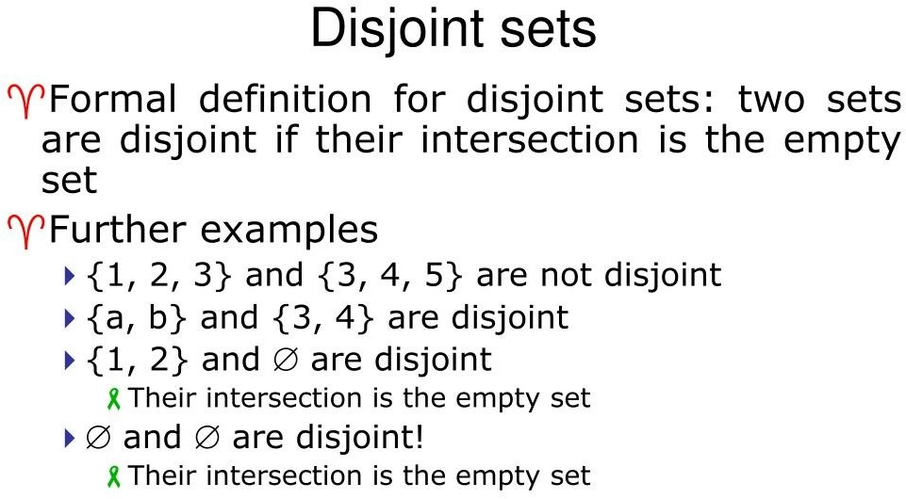
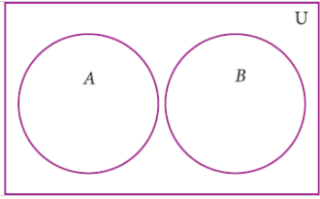

Slide 57
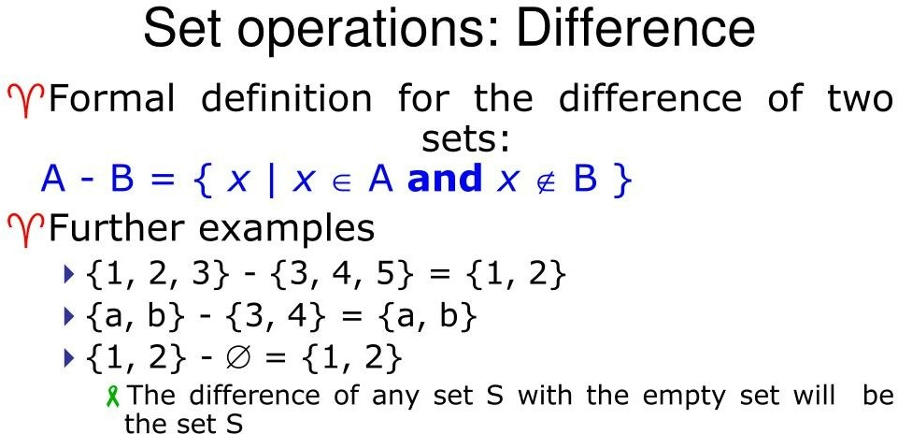
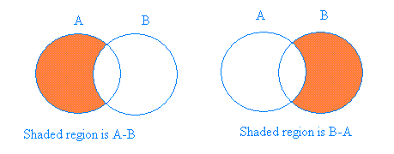

Slide 58
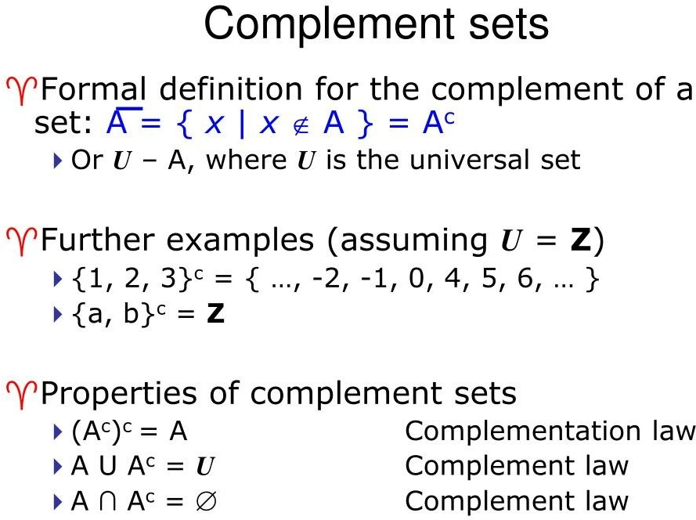
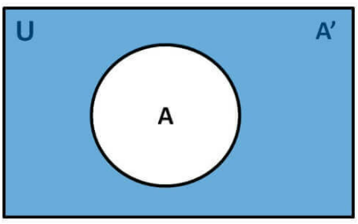

Slide 59
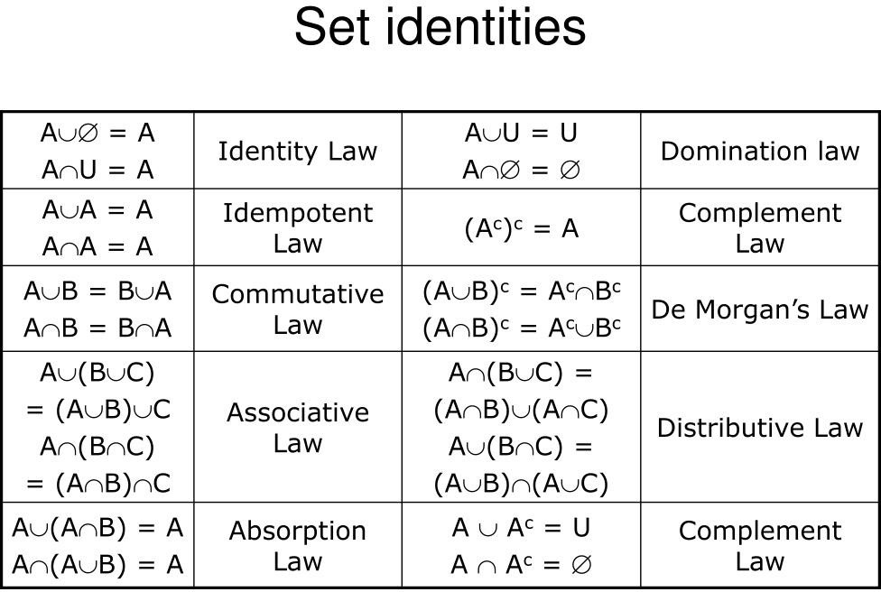

Slide 60
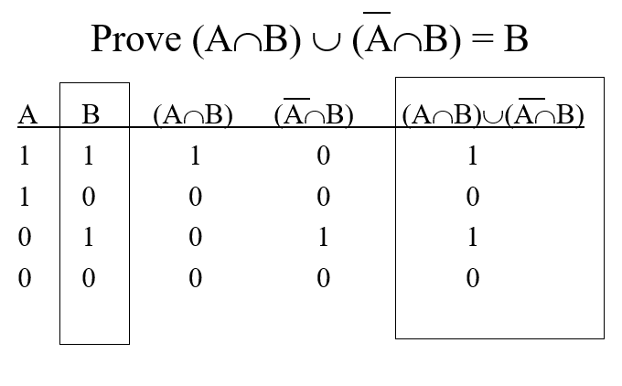
Membership tables

Slide 61

Using Set Identites

Slide 62

Using Venn diagram

Slide 63

Number of Subsets (Section 1.3 of book)

Slide 64

Number of Subsets (Section 1.3 of book)

Slide 65

Number of Subsets (Section 1.3 of book)

Slide 66


Number of Subsets (Section 1.3 of book)

Slide 67


Number of Subsets (Section 1.3 of book)

Slide 68


Number of Subsets (Section 1.3 of book)

Slide 69

Number of Subsets (Section 1.3 of book)
.

Slide 70


Number of Subsets (Section 1.3 of book)

Slide 71

Number of Subsets (Section 1.3 of book)

Slide 72

Number of Subsets (Section 1.3 of book)

Slide 73

Number of Subsets (Section 1.3 of book)

Slide 74

Number of Subsets (Section 1.3 of book)
How we list?
Let us list down all the subsets in a particular order, and then suppose we want to know what will be 233rd subset in this list, of a set with 10 elements???

Slide 75

Number of Subsets (Section 1.3 of book)
How we list?
Encoding the subsets with binary strings:
If an element is present, we mark it by ONE, if not present we put ZERO

Slide 76

Sequences (Section 1.5 of book)

Slide 77


Sequences (Section 1.5 of book)

Slide 78
Sequences (Section 1.5 of book)

Slide 79
Therefore O students, study mathematics and do not build without foundations
- Leonardo da Vinci (1452-1519)

Slide 80
Therefore O students, study mathematics and do not build without foundations
Leonardo da Vinci (1452-1519)
Go through the reading material:
Lovasz’s book – Chapter 1, Section 1.1 – 1.2

Slide 81
Therefore O students, study mathematics and do not build without foundations
Leonardo da Vinci (1452-1519)
My office:
F202, A block
Email: asim.raza@ucp.edu.pk
Office Hours:
Will be uploaded soon
or by appointment (email)

